Slide 1

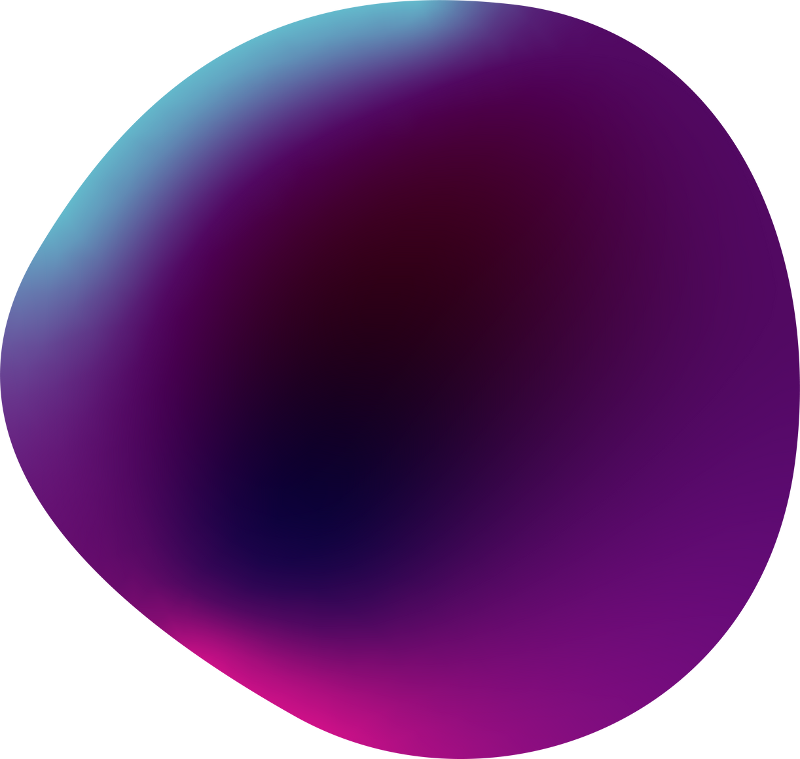

EthenaFun Game
Blockchain Gaming Experience

Slide 2

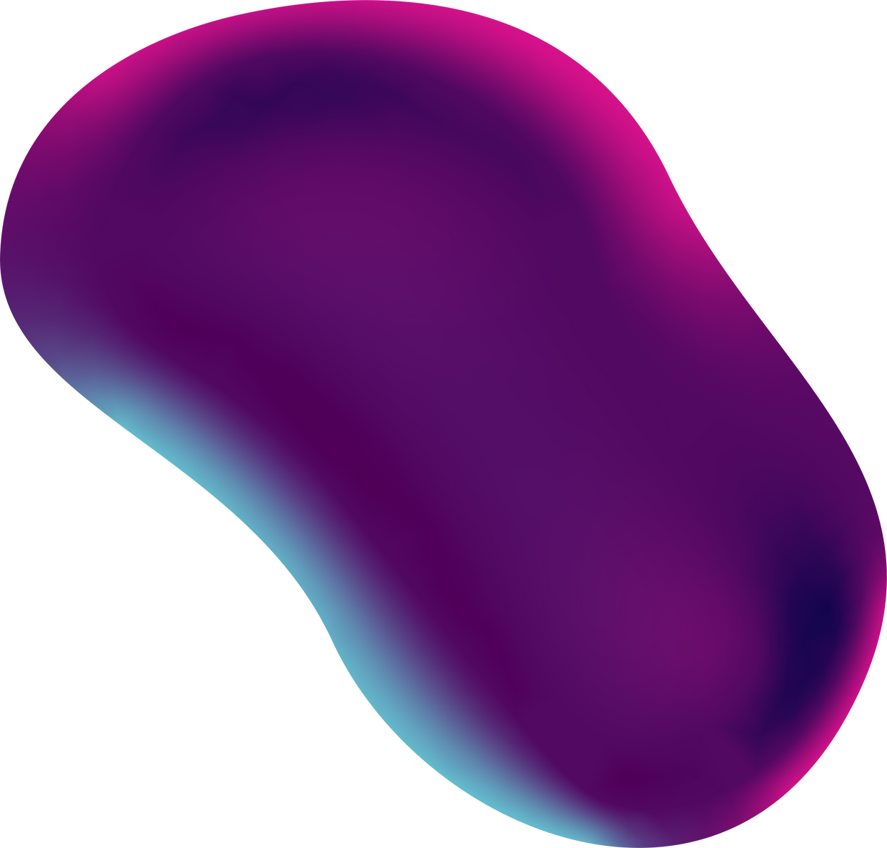
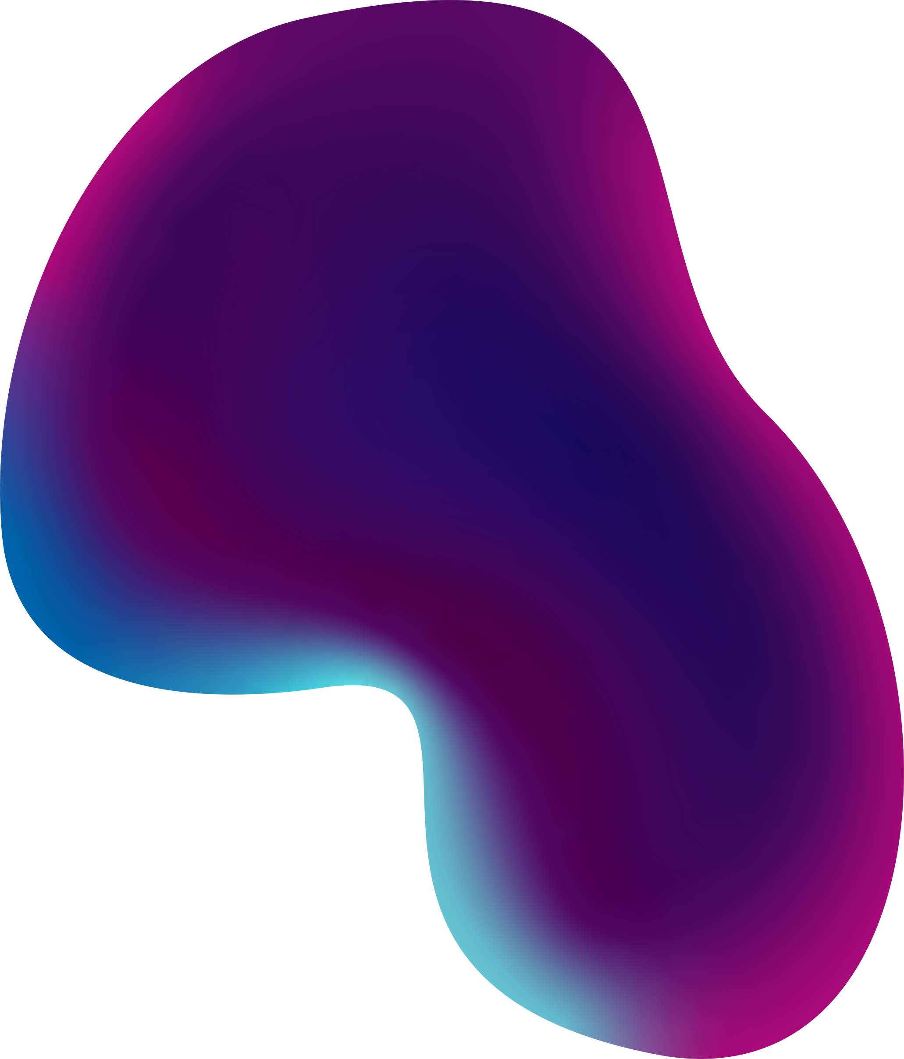
Presentation outline
02
Introduction to EthenaFun Problem & Solution
Key features
How it works Future Plans TechStack
Who Can use Developer Details Thankyou
Sales Presentation | December 2020

Slide 3
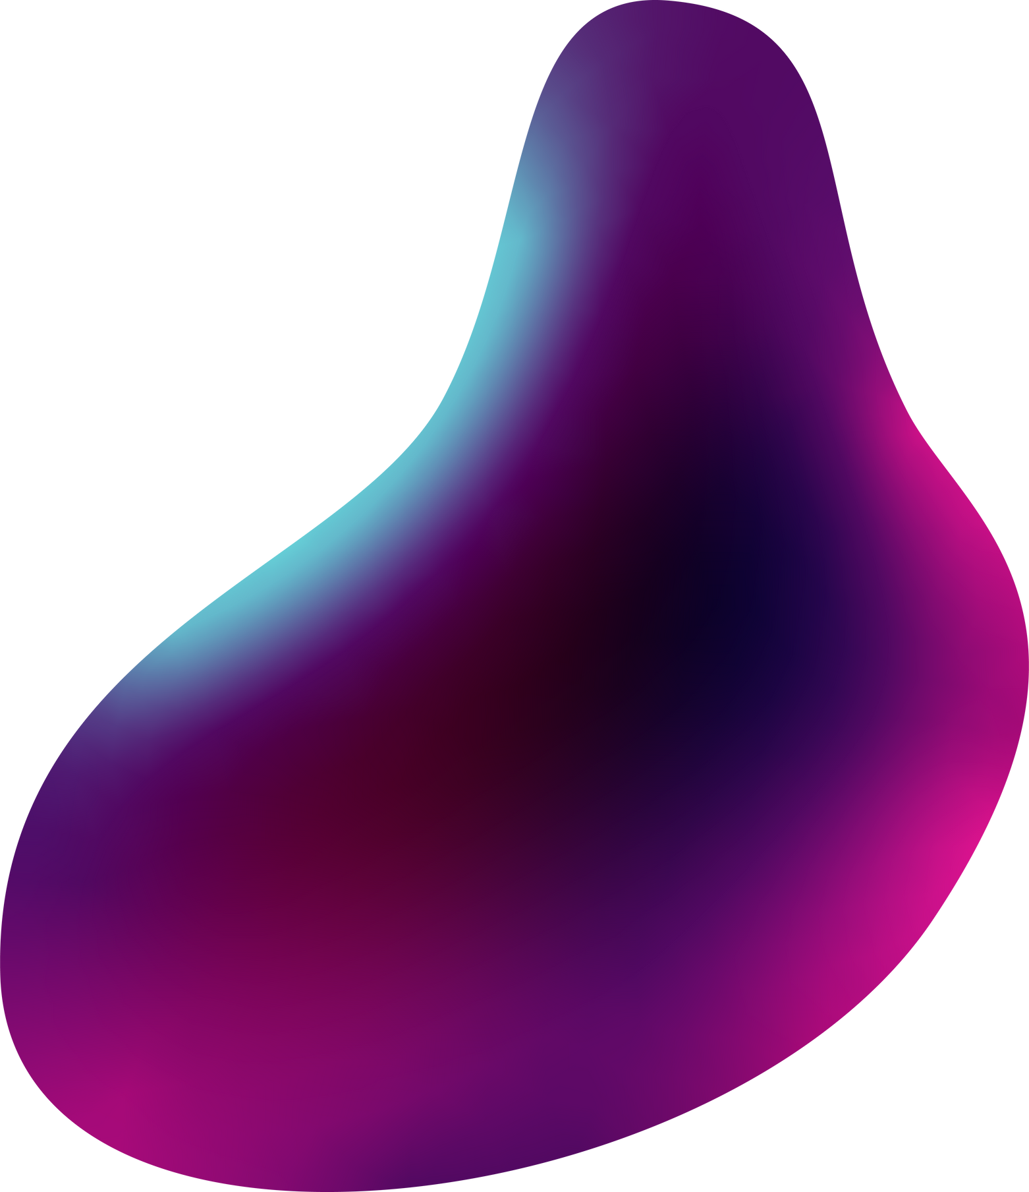
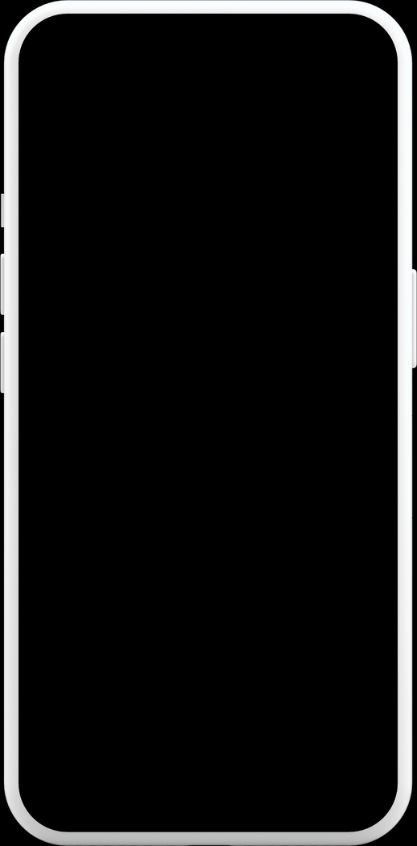
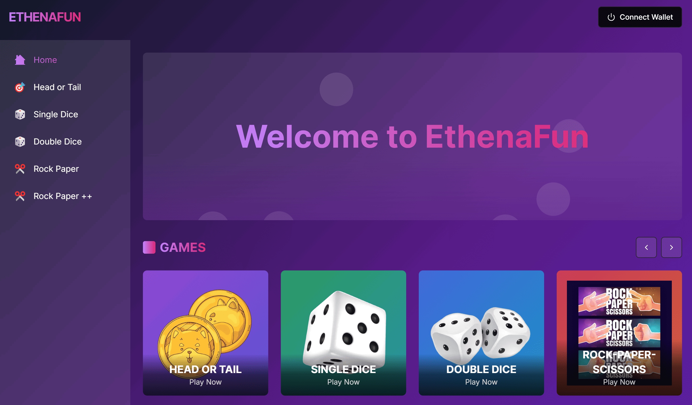
Introduction EthenaFun
EthenaFun: A Decentralized Gaming Platform
Bonus Rewards: Enhances the gaming experience.
USDe Stablecoin: Provides stability and security.
Decentralized Network: Offers autonomy and security (Ethena Network).

Slide 4
Problem
Problem
Lack of transparent and fair gaming options.

Slide 5
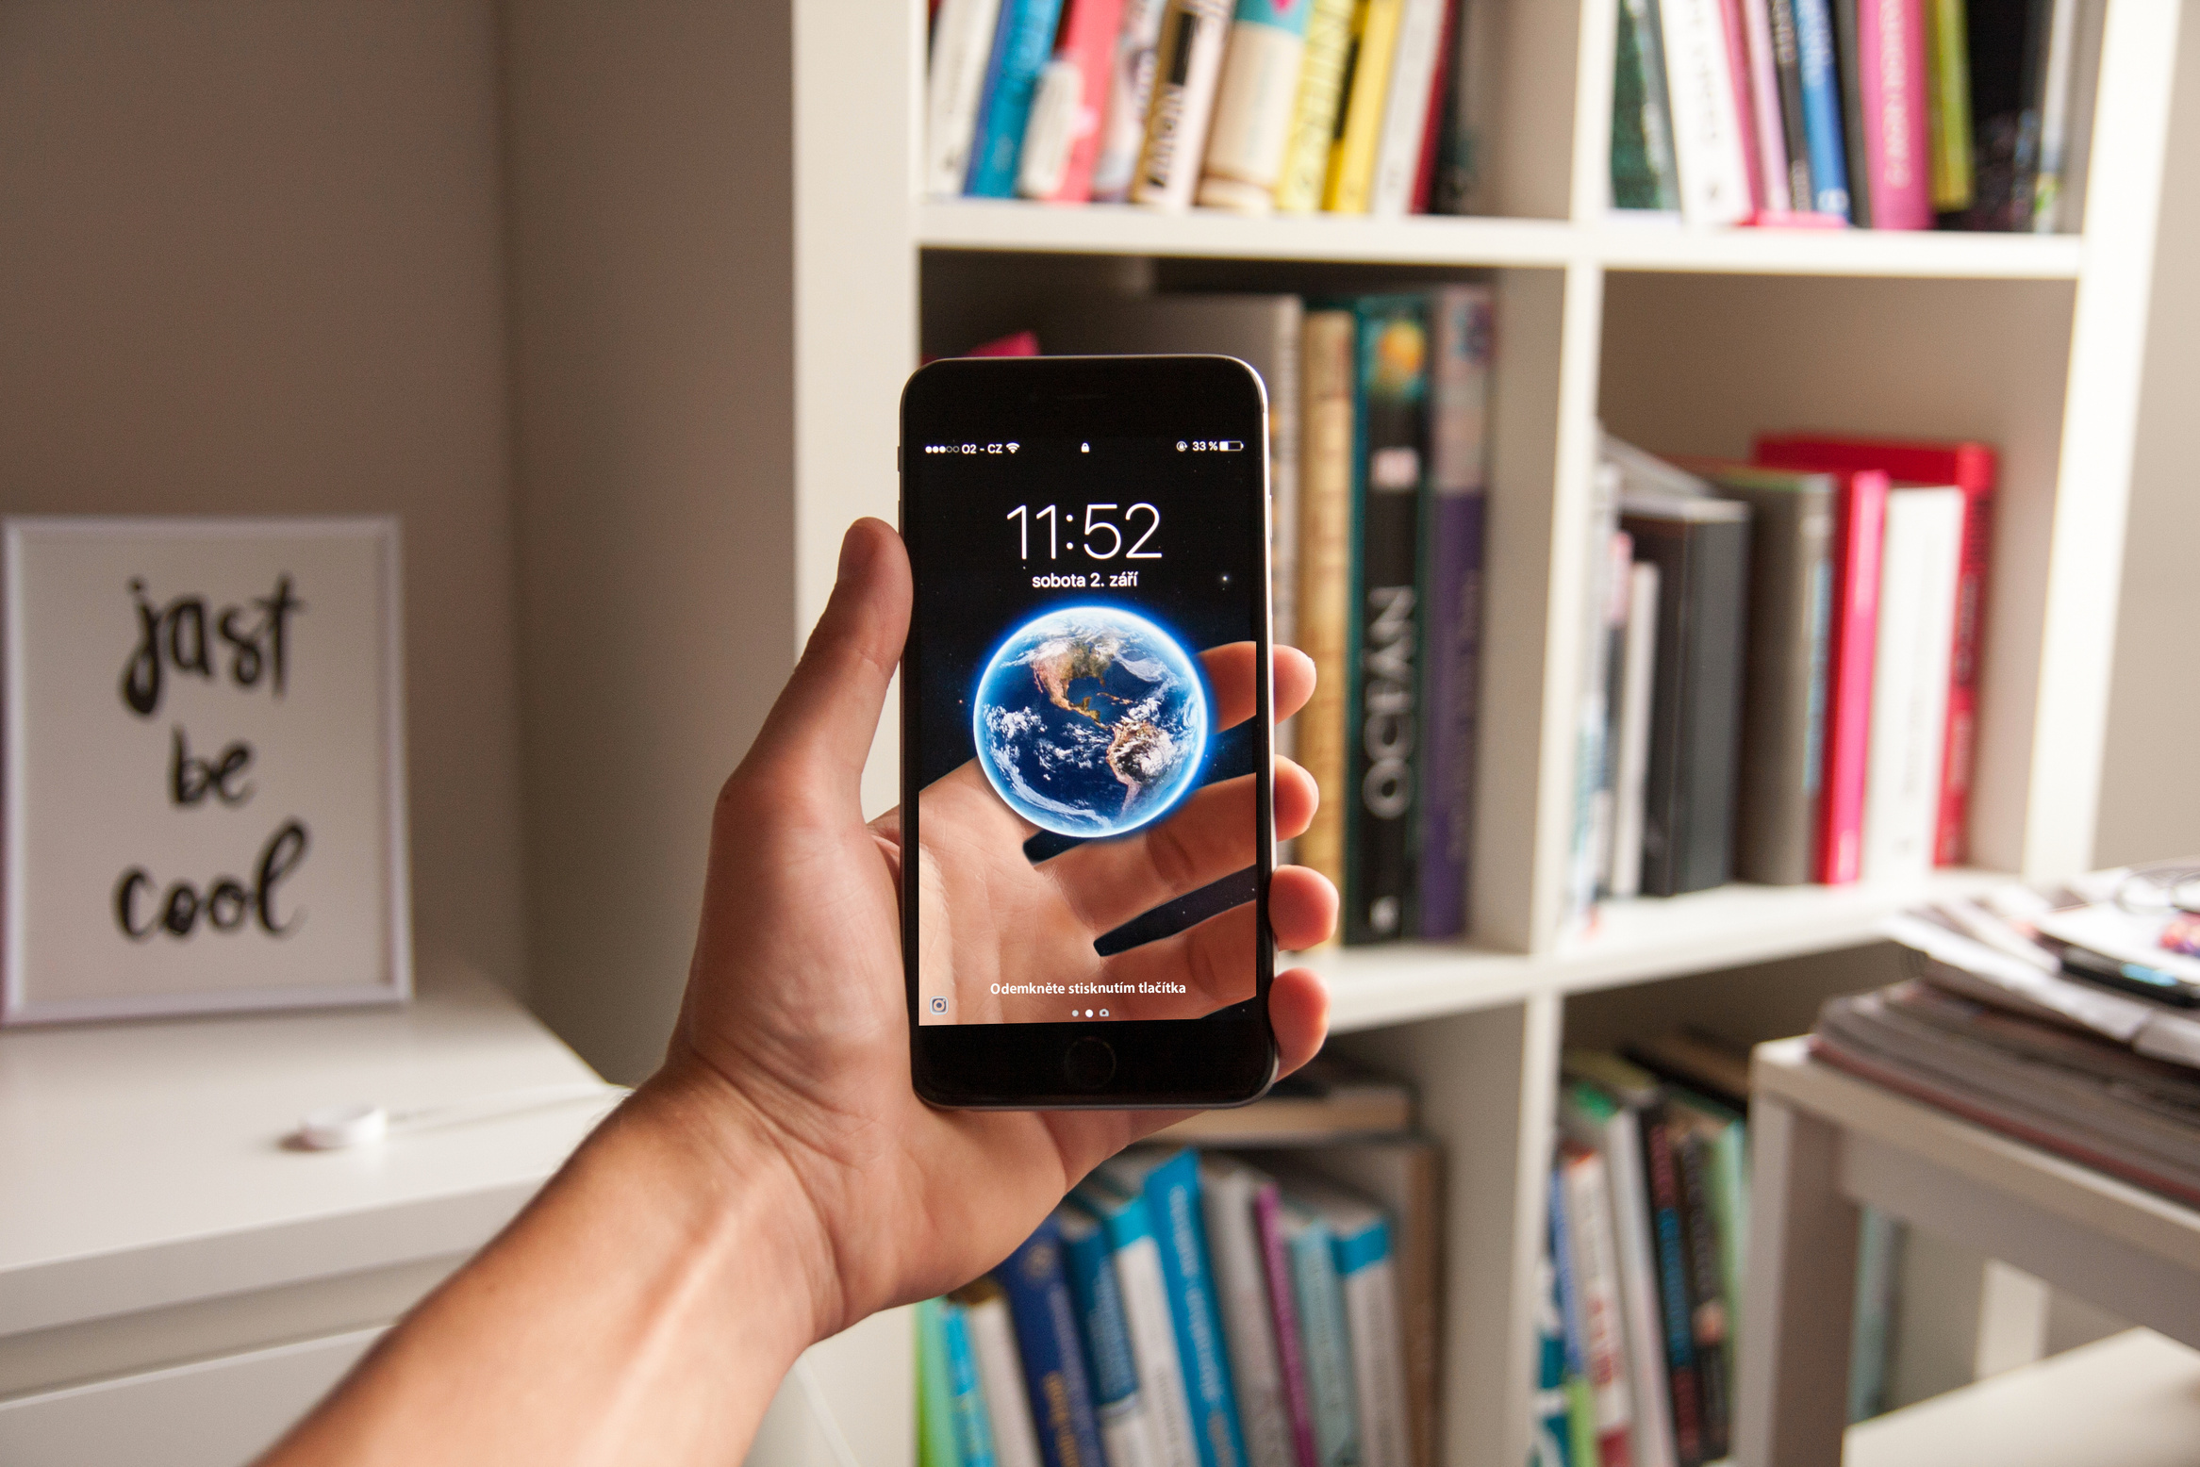
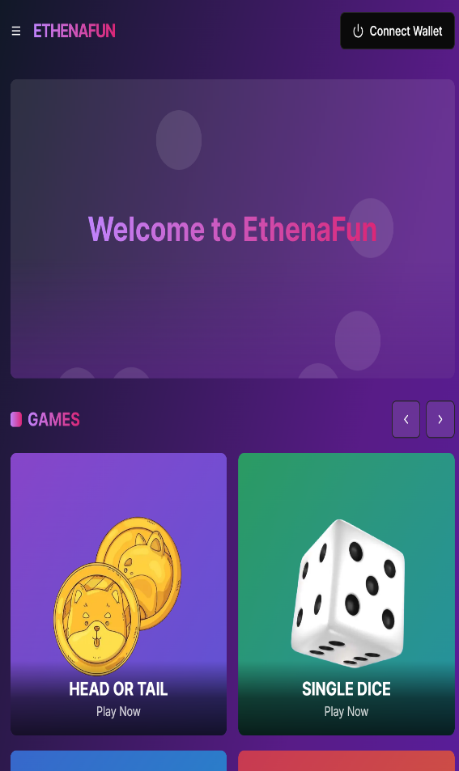
Solution
EthenaFun offers a decentralized, provably fair betting experience with secure blockchain technology.

Slide 6
Key features
EthenaFun offers a decentralized, provably fair betting experience with secure blockchain technology and engaging social features.
01
02
03
Feature 1
Feature 2
Feature 3
Automated token management
Real-time statistics and leaderboards
Bonus multipliers and rewards

Slide 7
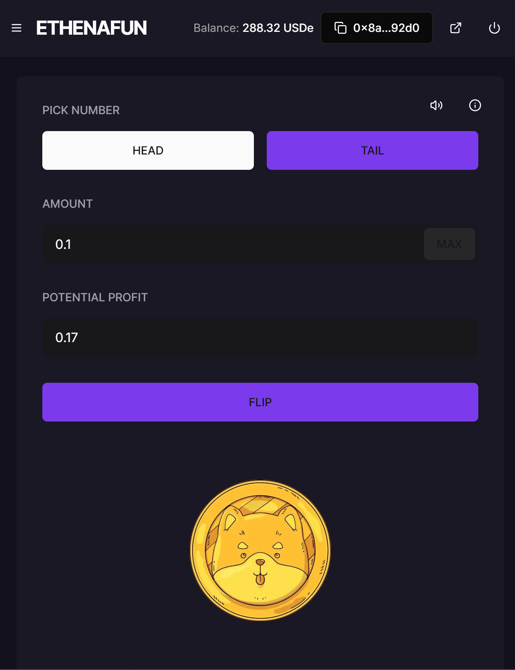
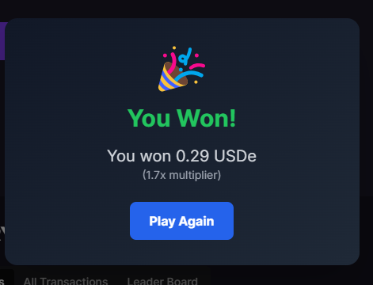
How it
works
Connect Wallet >
Select Bet Amount >
Play Head or Tail >
Monitor Game Stats >
Collect Winnings
😀🤑💸

Slide 8
08
Solution
Presentations are tools that can be used as demonstrations, lectures, speeches, reports, and more.

Slide 9
Future Roadmap
NFT gaming experience
Enhanced community engagement
Collaborations with other platforms
Expanding game offerings

Slide 10
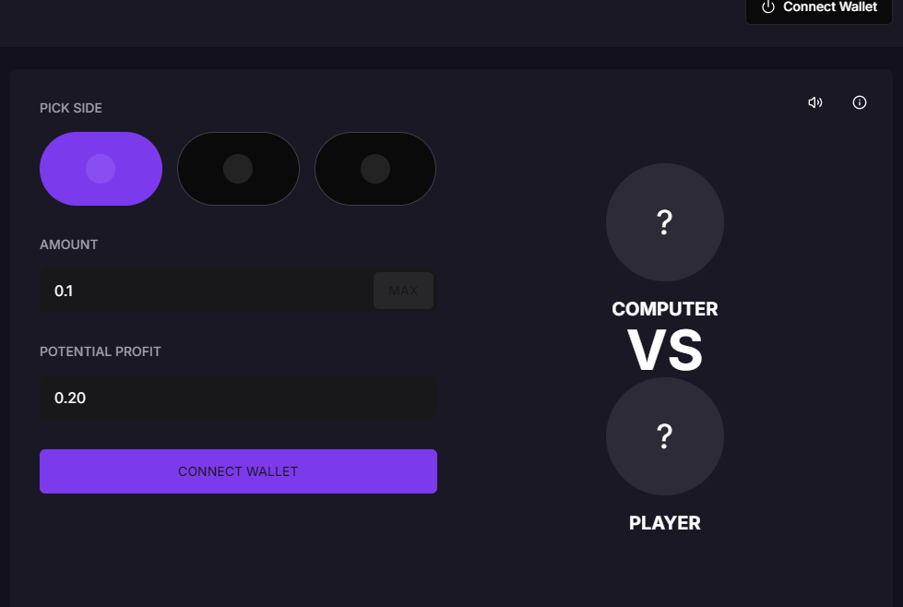
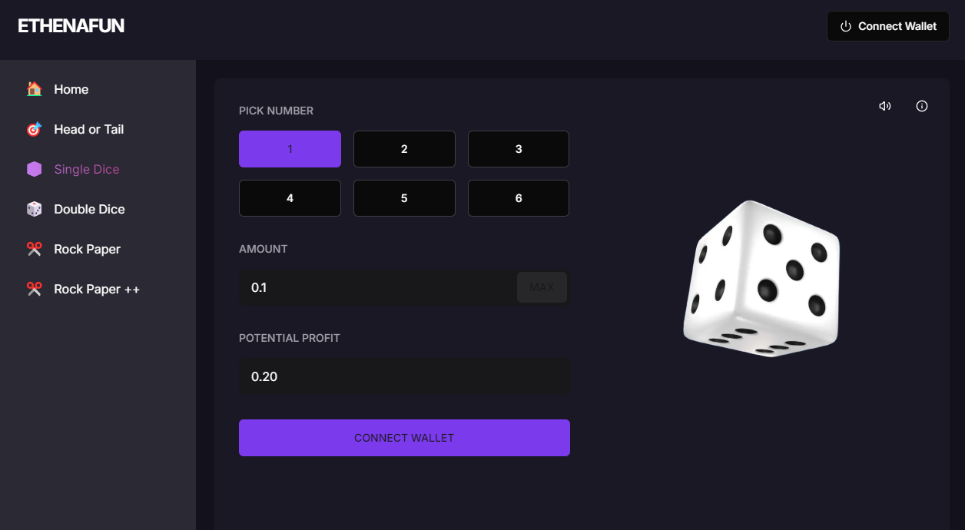
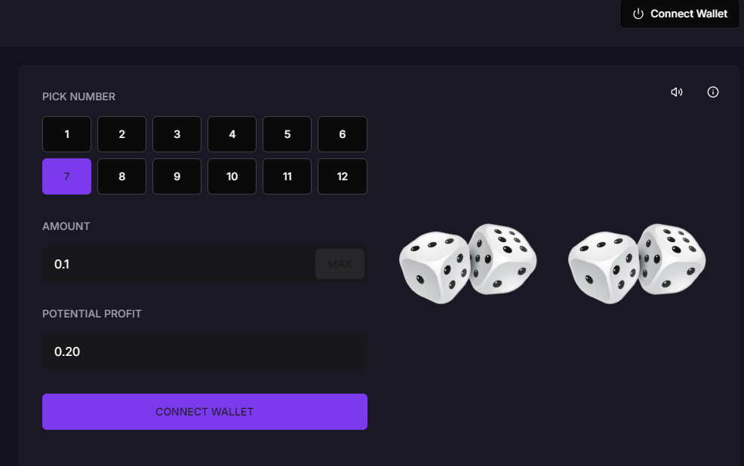
Future Roadmap
Working on these other web3 games functionalities- Need web3 integration the ready to use

Slide 11
Target customers
06
01
02
03
Persona 1
Persona 2
Persona 3
General characteristic
General characteristic
General characteristic
Presentations are tools that can be used as demonstrations.
Presentations are tools that can be used as demonstrations.
Presentations are tools that can be used as demonstrations.

Slide 12
Pricing
Basic
Presentations are tools that can be used as demonstrations.
Advanced
Presentations are tools that can be used as demonstrations.
Premium
Presentations are tools that can be used as demonstrations.

Slide 13
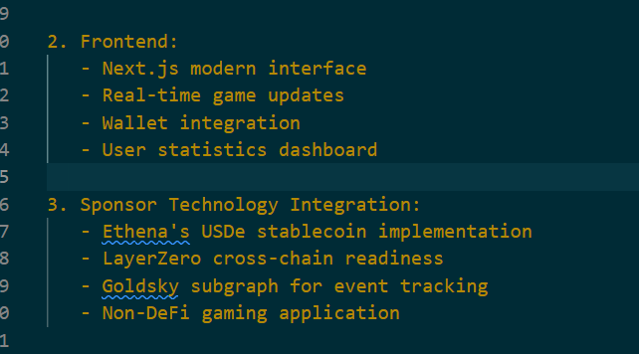
Tech Stack and Web3 Components
It consists of various components such as Smart Contracts, Frontend Interface, Backend Server, and Blockchain Integration, each playing a crucial role in maintaining the game's functionality and fairness.

Slide 14
Who Can use
Anyone can play this game; they just need USDe Token on the Ethena Network. They can play this with a minimum of 0.1 USDe.

Slide 15
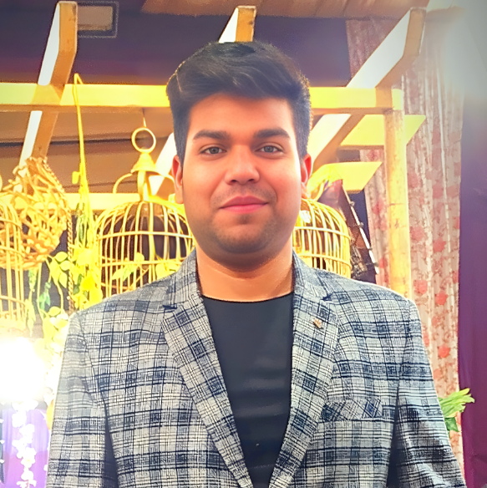
Solo Dev of this project
Arpit Singh
Full stack Blockchain Development learner

Slide 16
Contact me
EthenaFun Game (Ethena Hackathon)
https://ethenafun.vercel.app
Email Address
arpitsinghthakur321@gmail.com
Twitter/LinkedIn/Telegram
@arpitweb3

Slide 17
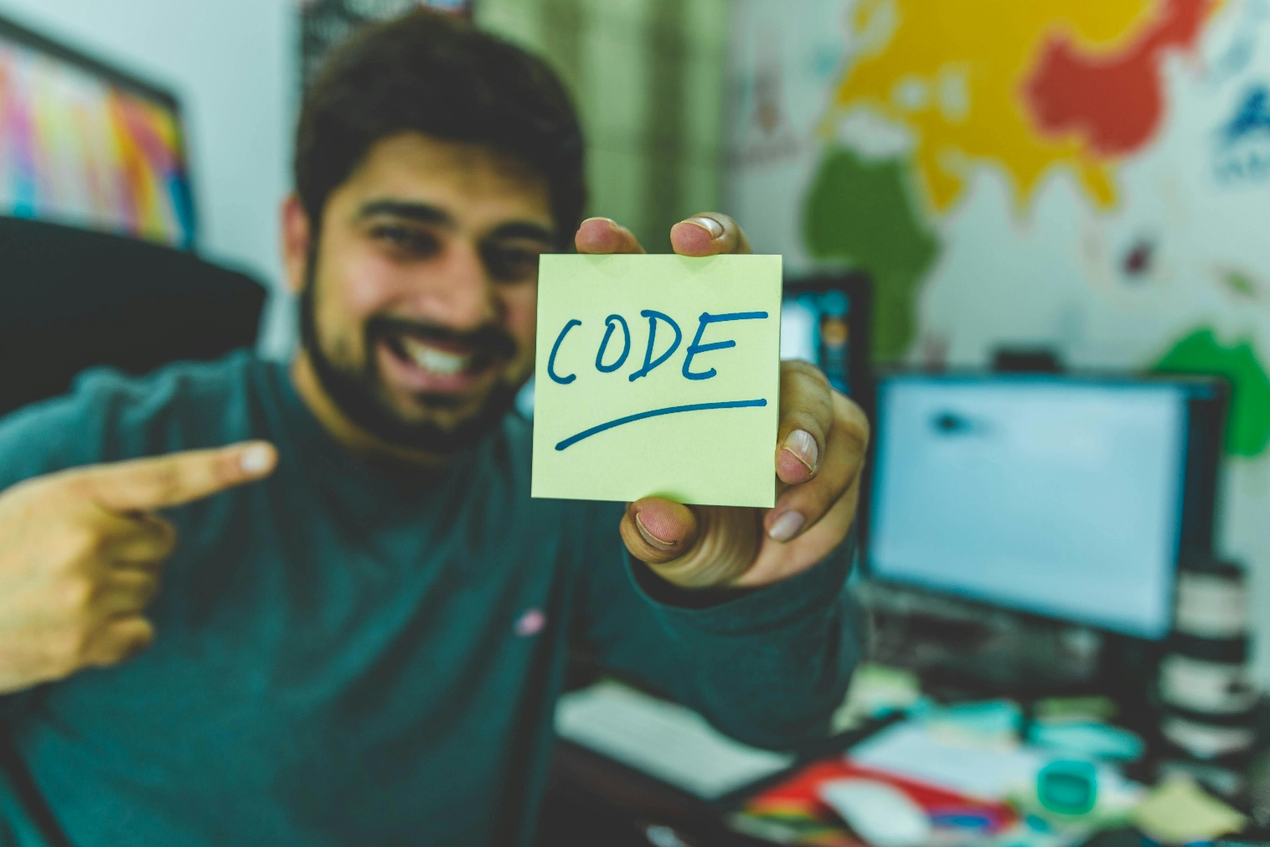
Thankyou 🙂

